Slide 1
Aphasia
Hack for Good by Team Skate Gang

Slide 2
/a-pha-si-a/
“You just sort of feel trapped, like you can’t have a conversation with anyone.”
“Language is uniquely human.”
the loss of ability to produce and/or understand language

Slide 3
/a-pha-si-a/
Social isolation
Loss of independence
Unemployment
Depression
the loss of ability to produce and/or understand language

Slide 4
33% of all stroke survivors
persons with head trauma, brain infections, dementia ...

Slide 5
= 2 million Americans alone
living with an incurable disability

Slide 6
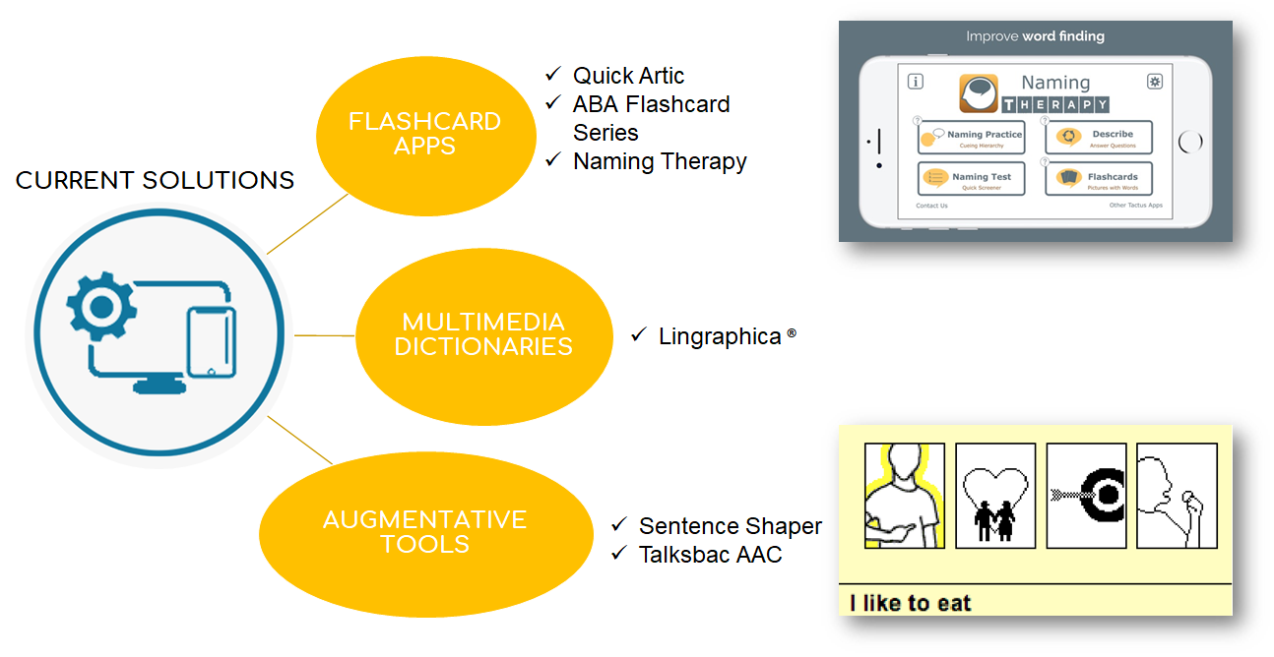

Slide 7
Focused on rehabilitating FUNCTION

Slide 8
Community Engagement
“Previously, people with disabilities advocated for the right to physically access shops. Today they face a similar fight for the right to digital participation.”
(Brandenburg et al., 2013)
Beyond just function! We must address activity limitation and participation restriction.

Slide 9
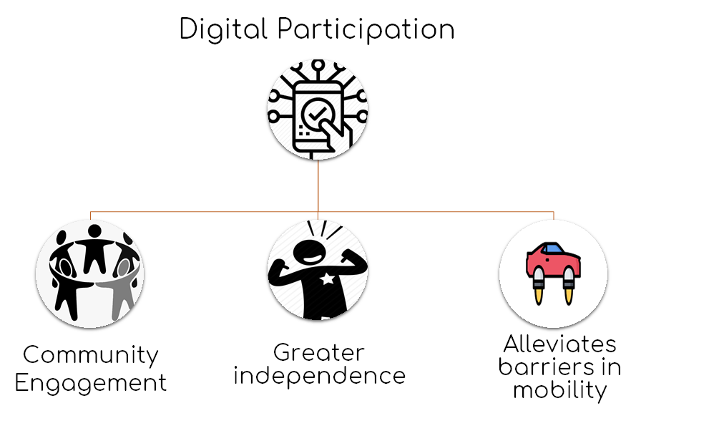
Notes:
Reneland-Forsman et al., 2018: Digital participation allows for older persons to maintain a social life, to access the health sector, to enjoy integrity and independence and cultural recreation. The opportunity for better control over personal economy (e.g. banking, bills) seemed to have worked as a trigger for activity and a means for facing obstacles associated with a better control using digital media.
Niehaves & Plattfaut, 2014: Many countries have started a process of dismantling analogue ways of interacting in social, cultural, political and commercial contexts.
25% of stroke patients still have difficulty walking 4 months post stroke + as we age more of the population will want to remain involved in the digital sphere

Slide 10
Problem = Poor Accessibility
Persons with aphasia
Stroke survivors
Elderly
can struggle with comprehending text
can struggle with fine motor control
can struggle with visual impairment

Slide 11
Solution

Slide 12
A Pager
Accessible Webpages

Slide 13
A Pager
simplifies and re-orders online marketplace webpages to display pertinent information clearly and concisely

Slide 14
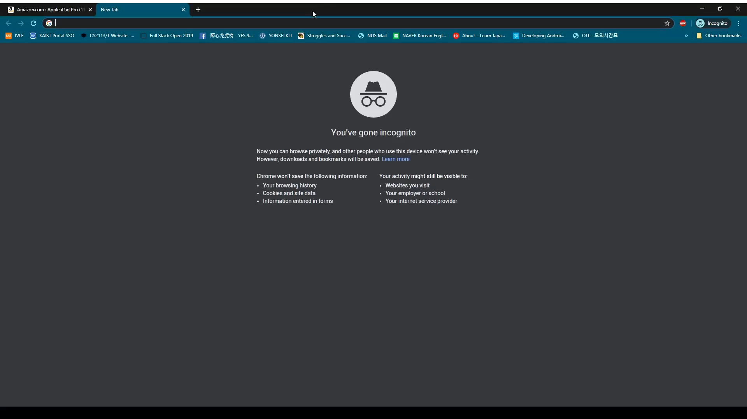

Product Video
(sound on!)
https://a-pager.herokuapp.com/
https://github.com/Lunastryke/a-pager.git

Slide 15
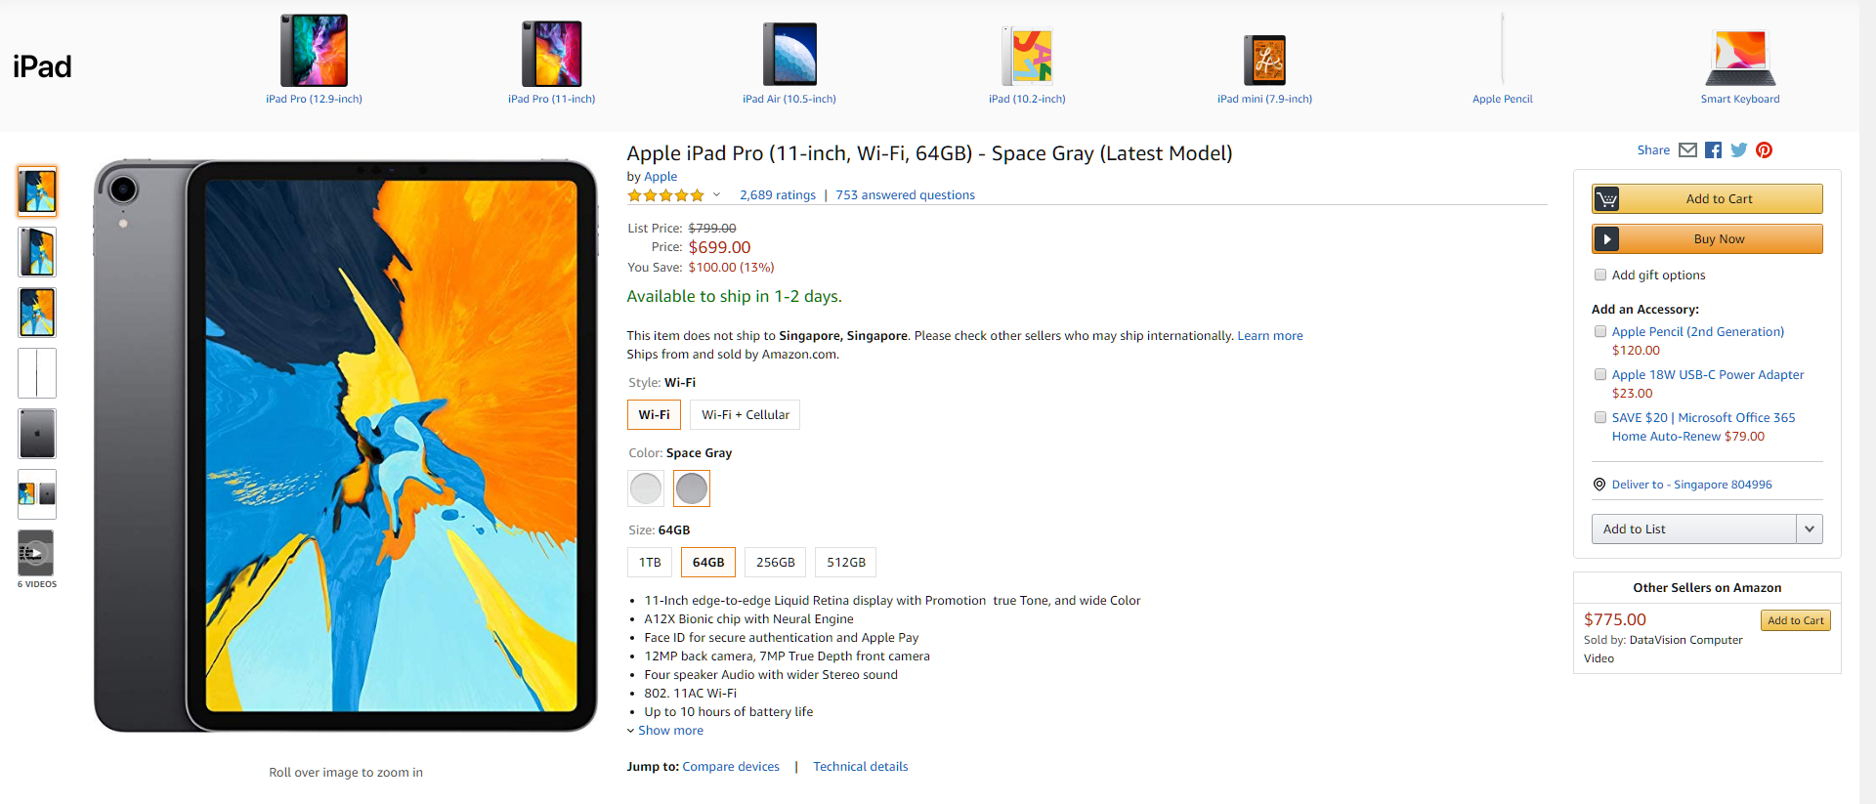
From this….

Slide 16
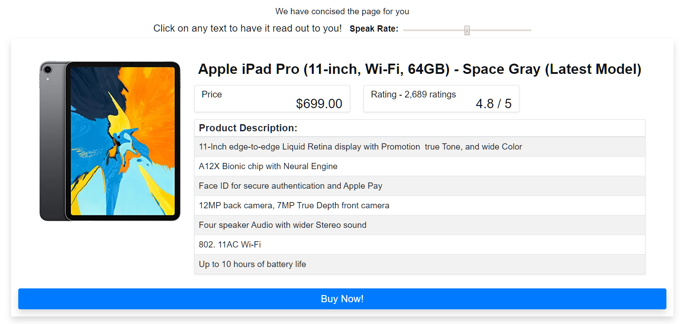
...to this!

Slide 17
Sometimes little tweaks solve big problems
Notes:
We have tailored our app to make it
especially user friendly for aphasia patients.
Aphasia patients has difficulty in reading
we have made a text to speech option.
For patients with more severe conditions
they can adjust to a lower speaking speed rate.
Firstly we specially increased the size buttons
and text to make it easier to click since most
of aphasia patients have impaired hand movement
abilities.
Our app seives out essential information in a
shopping page as we do not want aphasia patients
to take in too many information.
We are unable to get access to Amazon products
api as it is restricted. Currently we use web
scrappng techniques to get information that
are loaded on the actual site.
So which area should we focus on to improve
quality of life of aphasia patients.
We are focusing on making aphasia patients
more independent as we think it is the most
important prerequisite to stay interconnected
to the society.

Slide 18


BARRIERS IDENTIFIED | OUR SOLUTION
Difficulty reading | Text-to-speech option Customisable speak rate Use of recommended sans serif fonts
Information overload | Indispensable information first Clean UI
Size of screen and buttons | Large text, pictures and buttons
*Brandenburg et al., 2013, Van de Sandt-Koenderman, 2004

Slide 19
Progress and Challenges
😭 Access to Amazon’s secure API
We used web scrapers!
But lack of access to the API limited development of the full product idea.

Slide 20

improve quality of life

Slide 21
Independence
Social
Inclusion
Employment
Mental
Well-Being
The barriers to meaningful engagement in society are interconnected - facilitating independence and confidence has wider impacts.

Slide 22
extensive reach
Learning disabilities / visual impairments / unfamiliar with technology...
Notes:
✔ aphasia
✔ visual impairments
✔ motor deficits
✔ learning disabilities
✔ unfamiliar with technology

Slide 23
simple, but novel!
zero tools available for turning existing websites aphasia-friendly

Slide 24
scalability
shopping, news websites, banking, medical appointments...

Slide 25
cost effective

Slide 26

Future Direction
Working with Aphasia SG
Chrome Extension
Additional Features

Slide 27
“How many opportunities do we have to dramatically improve people’s lives just by doing our job a little better?” - Steve Krug

